Slide 1





Emotion Recognition
The process of a computer reading your pretty face
Rec. Img
Identify Face
Process Input
Img Shape
Analysis
Open CV
Normalize
Numpy

Slide 2
Pretrained Models
OpenCV’s frontal face classifier to detect faces
Uses Haar Feature-based cascade classifiers
Keras CNN to detect emotion
Trained by oarriaga using Keras and FER2013 dataset

Slide 3
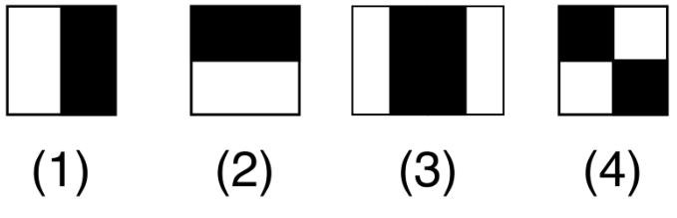
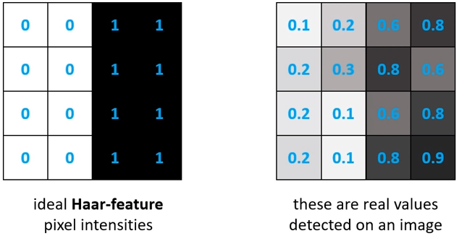
Haar-features
Used to detect edges and lines
Sums pixel intensities in each region and calculates the difference

Slide 4
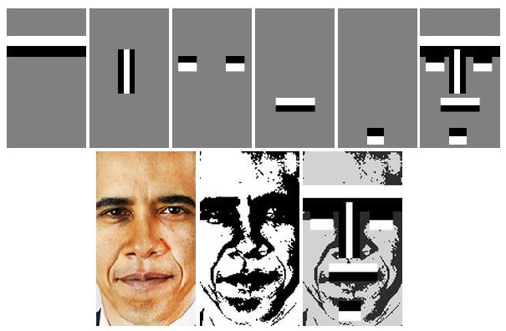
Haar-features
Kadir, Kushsairy Abdul et al. “A comparative study between LBP and Haar-like features for Face Detection using OpenCV.” 2014 4th International Conference on Engineering Technology and Technopreneuship (ICE2T) (2014): 335-339.

Slide 5
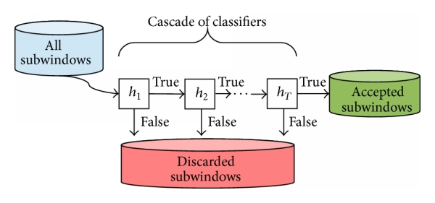


Slide 6
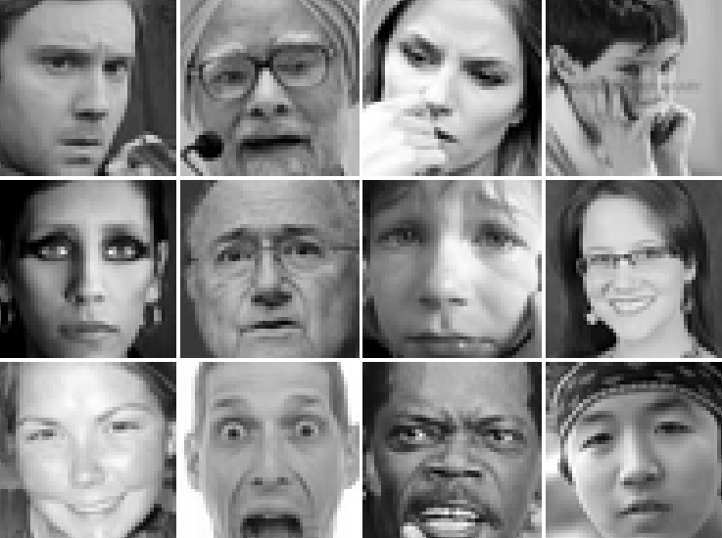
FER2013 dataset
35,000 face crops
Grayscale images
Resolution of 48 x 48 pixels

Slide 7
Blank

Slide 8
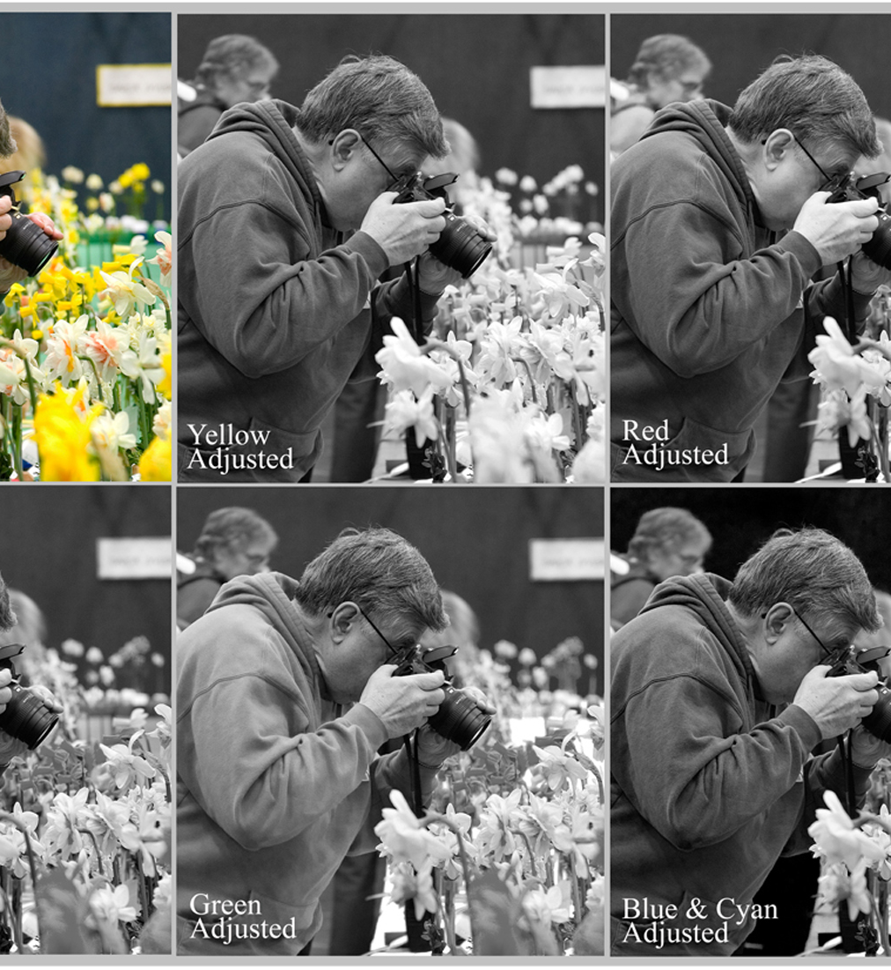
Preprocess_input()
Normalize all the pixels
Reason: That’s how the model was trained…?
It helps clearing the noise from different light setting
Imagine a very dark setting image vs a very light setting image

Slide 9
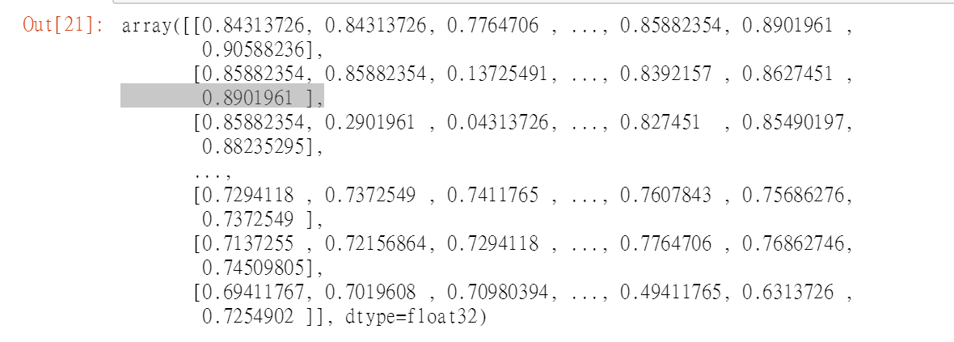
Image Shape
The image is an 48 by 48 array of pixels
Computer doesn’t understand it.
Np.expand_dims(processed, 0) add one bracket to the array, or adding one dimension to it.
Np.expand_dims(processed, -1) add one bracket to each pixel

Slide 10
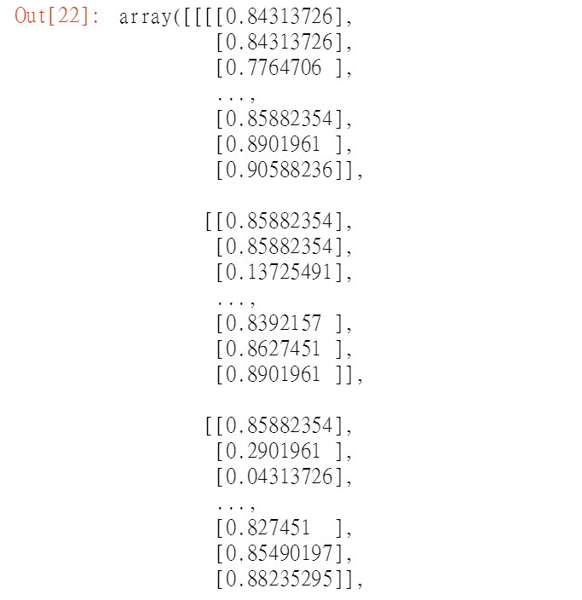
Image shape cont.
What does that all mean?????
By changing it to a (1,48,48,1) array from (48,48) you are telling the machine, there is one picture of 48 by 48 pixel with one kind of color.
Color pixel would be (1,48,48,3) where each pixel is an array of 3 color element, or the rgb(255,255,255)

